Slide 1

Rockbuster Stealth Data Analysis
By Alexander Guy

Slide 2
Hey what movies are you watching??
Ever since Louis Le Prince first film production was introduced to the world, humanity has been captivated by the silver screen. Prince’s motion picture, “Roundhay Garden” started something that would change the world 100 times over. We’re going to discuss how Rockbuster Stealth LLC can continue to change to the world through the power of the motion picture, by way of a new stream service. It will be a tough battle against the likes of Netflix and Amazon prime and a host of other stream service, but we will get it done let’s get into it!!

Slide 3
Objective
This analysis will answer a few business questions that will better help Rockbuster Stealth future performance. The data used is data gathered from 2020.

Slide 4

Key Questions
Which movies contributed the most/least to revenue gain?
What was the average rental duration for all videos?
Which countries are Rockbuster customers based in?
Where are customers with a high lifetime value based?
Do sales figures vary between geographic regions?

Slide 5
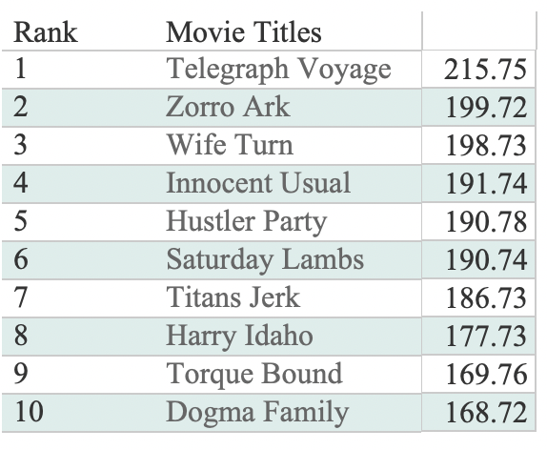
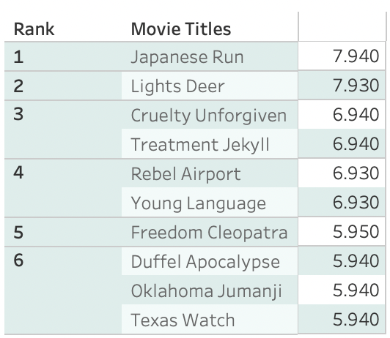
Frist, we start with the movies that bring in the most money and those movies nobody wants or the movies that bring in the least amount of revenue.
Top 10 Money Making Movies
Nothing to Write Home About

Slide 6
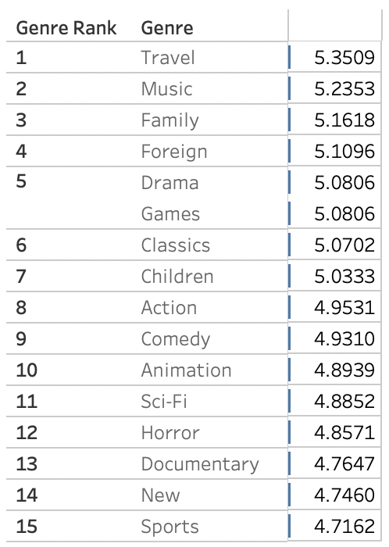
Here you can see the rental duration by Genre

Slide 7
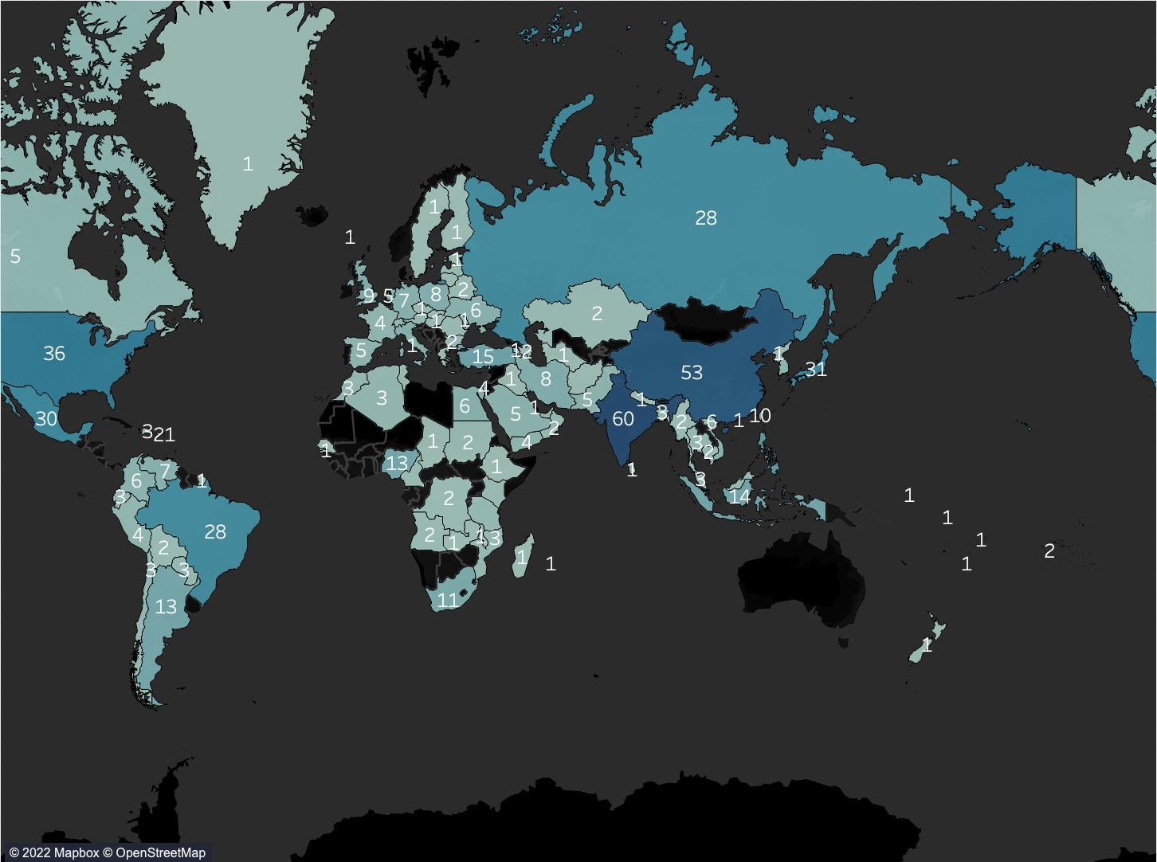
Rockbusters loyalist are all over the world, but these countries are where Rockbuster is loved the most. Top countries: 1. India = 60 2. China = 53 3. United States = 36 4. Japan = 31 5. Mexico = 30 6. Brazil = 28 7. Russian Federation = 28 8. Philippines = 20 9. Turkey = 15 10. Indonesia = 14

Slide 8
Rockbuster Top 5 Loyalist
Name | City | Country | Amount Spent
Sara Perry | Atlixco | Mexico | 128.70
Gabriel Harder | Sivas | Turkey | 108.75
Sergio Stanfield | Celaya | Mexico | 102.76
Clinton Buford | Aurora | United States | 98.76
Adam Gooch | Adoni | India | 97.80

Slide 9
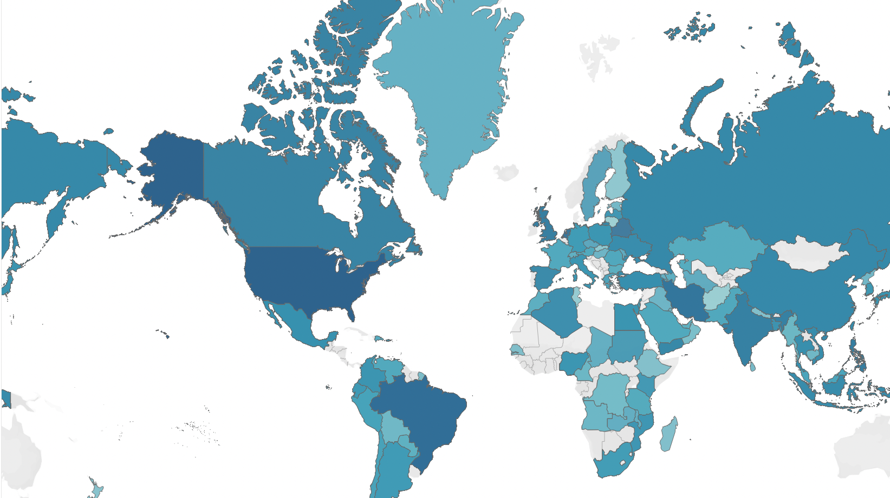
Countries that generate the most Revenue
Country | Total Revenue
Reunion (Department Of France) | 211.55
United States | 208.58
Brazil | 194.61
Netherlands | 191.62
Belarus | 189.6
Iran | 183.63
United Kingdom | 174.54
United States | 167.67
Canada | 167.62
Philippines | 166.61

Slide 10
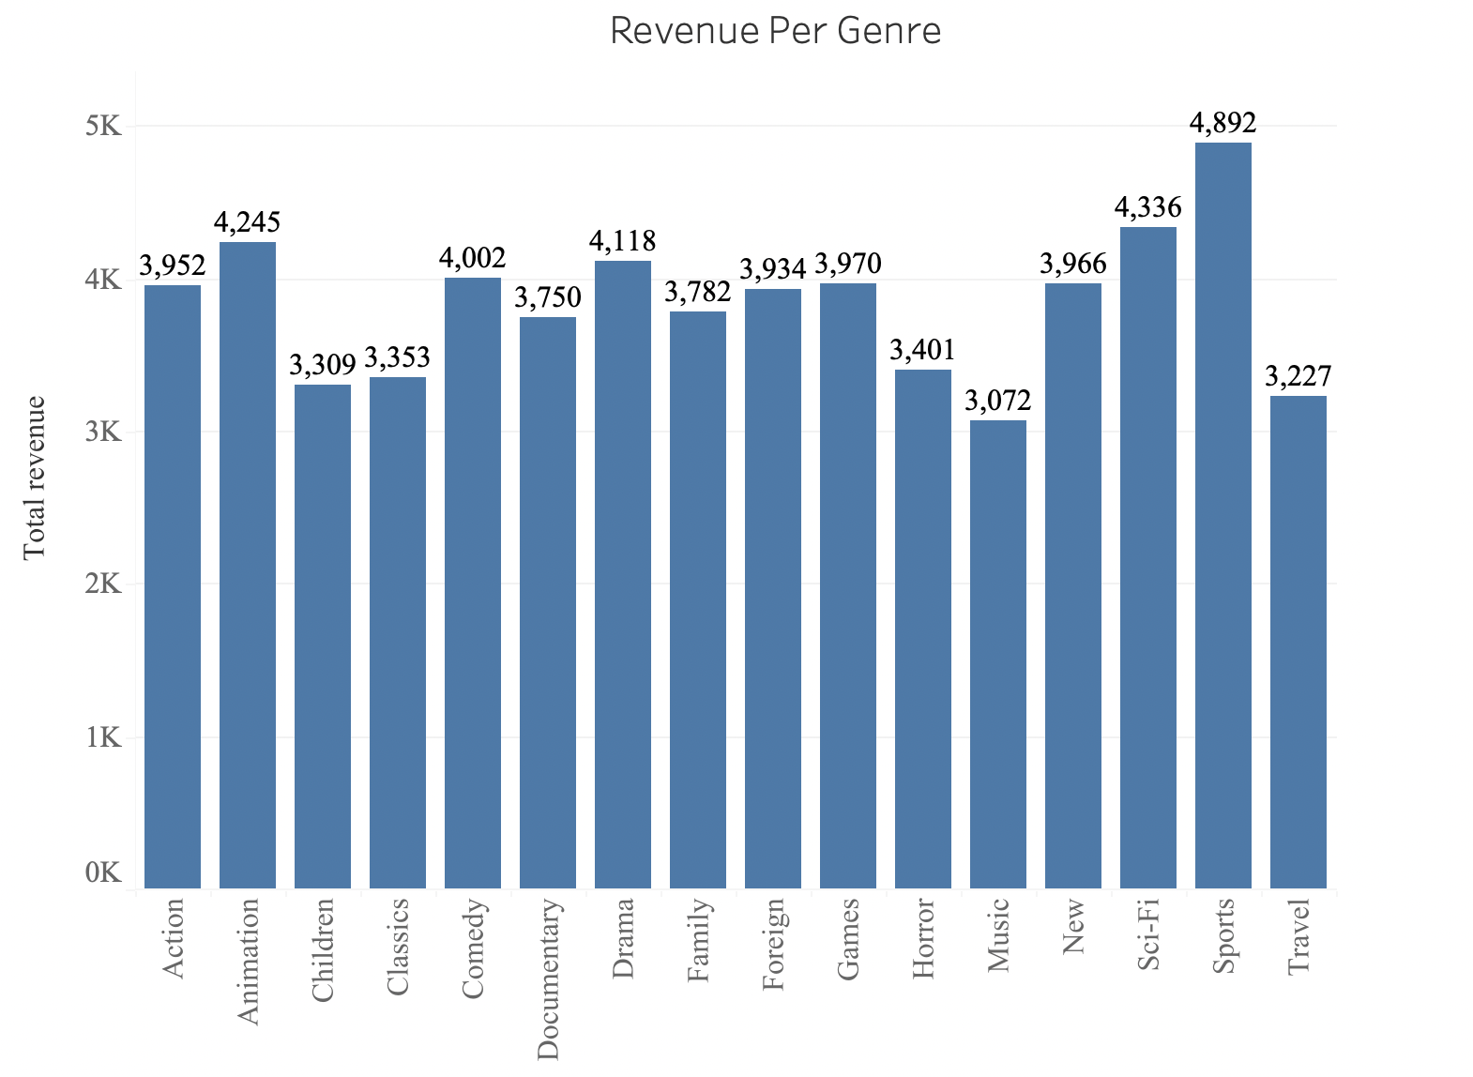
Revenue by Genre
Top 5
Sports
Sci-fi
Animation
Drama
Comedy

Slide 11
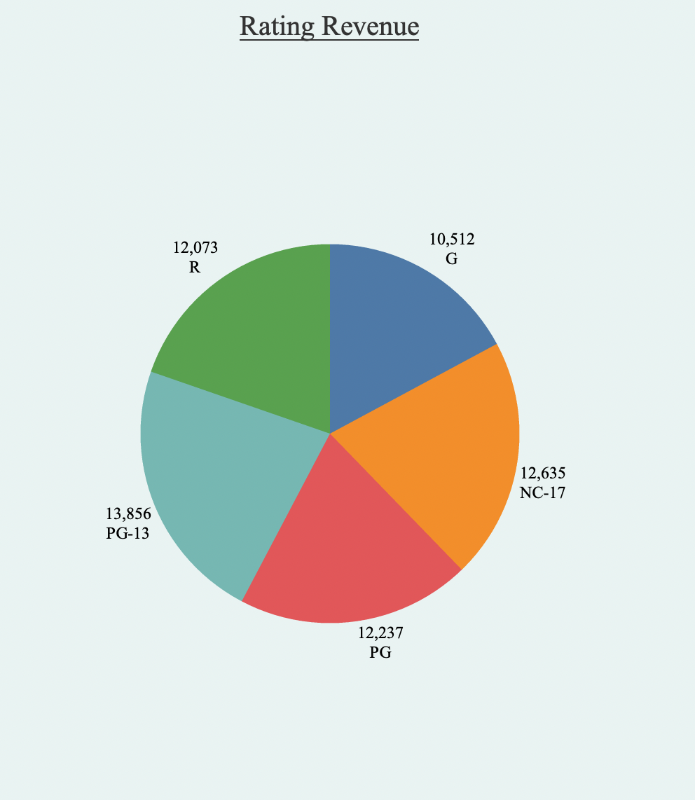
Revenue by Movie Rating

Slide 12

Recommendations
Promote movies that generate the most revenue.
Run bigger ad campaigns in countries that generate the most revenue. Especially in countries like India, China, and the United States. Since this countries have very large populations.
Promote Rockbuster Loyalist on company social media. Offer them rewards for there loyalty.

Slide 13
FIN
Tableau link
https://public.tableau.com/authoring/Rockbuster_16648648638290/Top10Movies#2

